Slide 1

Computer Organization & Assembly Language
Lecture-1
Introduction
Dr. Imtiaz Hussain
Professor
Department of Electrical and Computer Engineering
Iqra University, Karachi, Pakistan
email: imtiaz.hussain@iqra.edu.pk
Fall 2024

Slide 2
Today
Introduction
Digital Logic Circuits
Digital Components

Slide 3
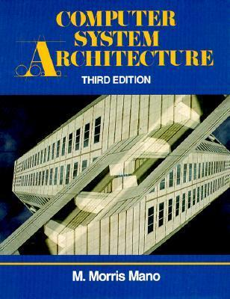
Textbook
M. Moris Mano, Computer System Architecture, 3rd Ed.

Slide 4
Digital Computer
The digital computer is a digital system that performs various computational tasks.
The word digital implies that the information in the computer is represented by variables that take a limited number of discrete values.
Digital computers function more reliably if only two states are used.
Because of the physical restriction of components, and because human logic tends to be binary, digital components that are constrained to take discrete values are further constrained to take only two values and are said to be binary.

Slide 5
Digital Computer
Digital computers use the binary number system, which has two digits: 0 and 1.
A binary digit is called a bit.
Information is represented in digital computers in groups of bits.
By judicious use of binary arrangements and by using various coding techniques, the groups of bits are used to develop complete sets of instructions for performing various types of computations.

Slide 6
Digital Computer
In contrast to the common decimal numbers that employ the base 10 system, binary numbers use a base 2 system with two digits: 0 and 1.
The decimal equivalent of a binary number can be found by expanding it into a power series with a base of 2.

Slide 7
Digital Computer
The seven bits 1001011 represent a binary number whose decimal equivalent is 75.
However, this same group of seven bits represents the letter K when used in conjunction with a binary code for the letters of the alphabet.
It may also represent a control code for specifying some decision logic in a particular digital computer.
In other words, groups of bits in a digital computer are used to represent many different things.

Slide 8
Digital Computer
A computer system is sometimes subdivided into two functional entities: hardware and software.
The hardware of the computer consists of all the electronic components and electromechanical devices that comprise the physical entity of the device.
Computer software consists of the instructions and data that the computer manipulates to perform various data-processing tasks.
A sequence of instructions for the computer is called a program.
The data that are manipulated by the program constitute the data base.

Slide 9
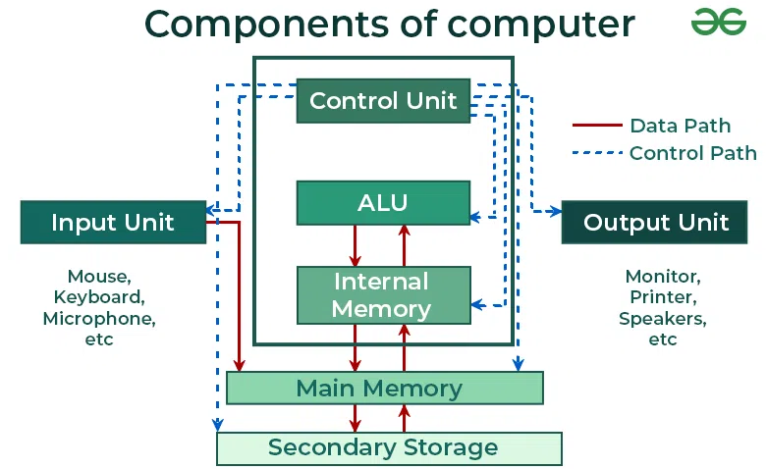
Digital Computer
The hardware of the computer is usually divided into three major parts.

Slide 10
Digital Computer
Computer organization is concerned with the way the hardware components operate and the way they are connected together to form the computer system.
The various components are assumed to be in place and the task is to investigate the organizational structure to verify that the computer parts operate as intended.

Slide 11
Digital Computer
Compute design is concerned with the hardware design of the computer.
Computer design is concerned with the determination of what hardware should be used and how the parts should be connected.

Slide 12
Digital Computer
Computer architecture is concerned with the structure and behavior of the computer as seen by the user.
It includes the information formats, the instruction set, and techniques for addressing memory.

Slide 13
Logic Gates
The manipulation of binary information is done by logic circuits called gates.
Gates are blocks of hardware that produce signals of binary 1 or 0 when input logic requirements are satisfied.
A variety of logic gates are commonly used in digital computer systems.
Each gate has a distinct graphic symbol and its operation can be described by means of an algebraic expression.
The input-output relationship of the binary variables for each gate can be represented in tabular form by a truth table.

Slide 14
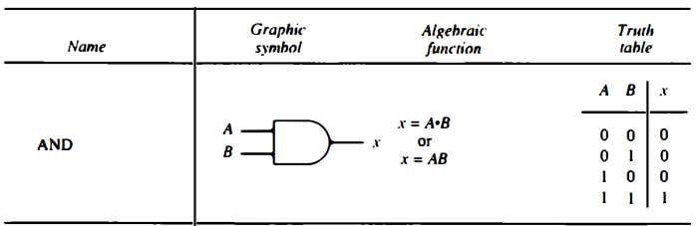
AND Gate
The AND gate produces the AND logic function: that is, the output is 1 if input A and input B are both equal to 1; otherwise, the output is 0

Slide 15
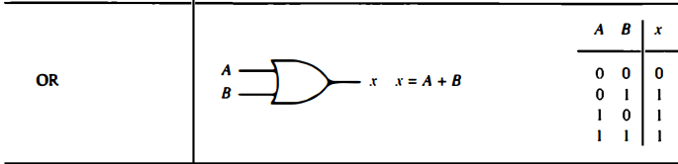
OR Gate

Slide 16
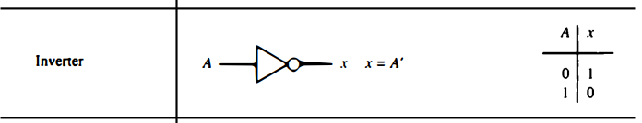
NOT Gate

Slide 17
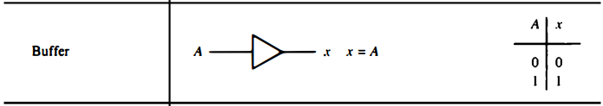
Buffer

Slide 18
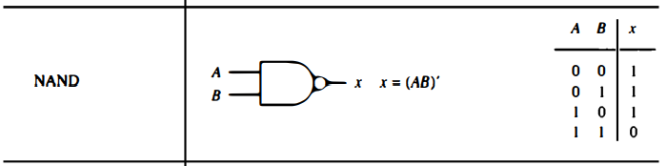
NAND Gate

Slide 19
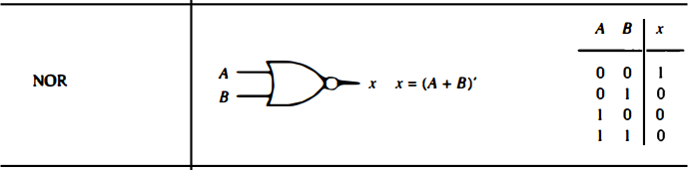
NOR Gate

Slide 20
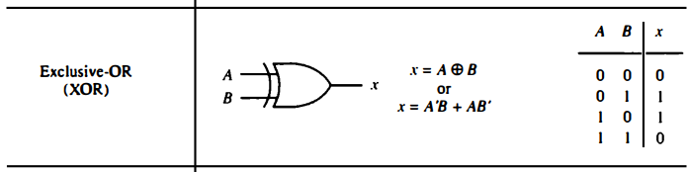
XOR Gate

Slide 21
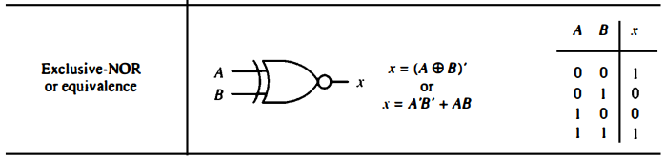
XNOR Gate

Slide 22

Boolean Algebra
Boolean algebra is an algebra that deals with binary variables and logic operations.
Consider, for example, the Boolean function

Slide 23
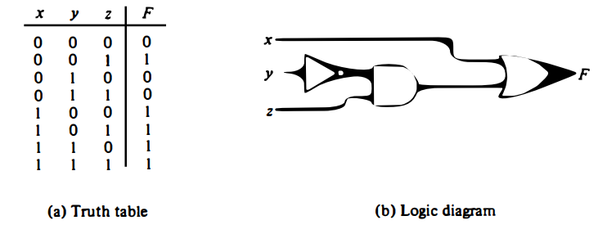
Boolean Algebra
Boolean algebra is an algebra that deals with binary variables and logic operations.
Consider, for example, the Boolean function

Slide 24
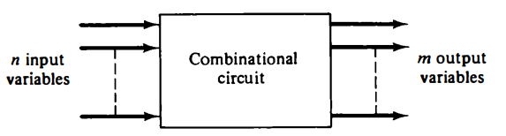
Combinational Circuits
A combinational circuit is a connected arrangement of logic gates with a set of inputs and outputs.
At any given time, the binary values of the outputs are a function of the binary combination of the inputs

Slide 25

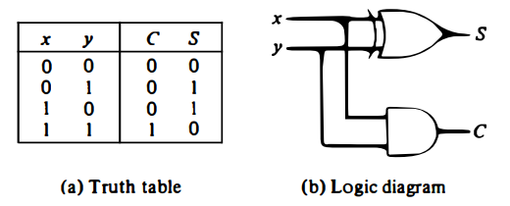
Combinational Circuits: Half Adder
The most basic digital arithmetic circuit is the addition of two binary digits.
A combinational circuit that performs the arithmetic addition of two bits is called a half-adder

Slide 26
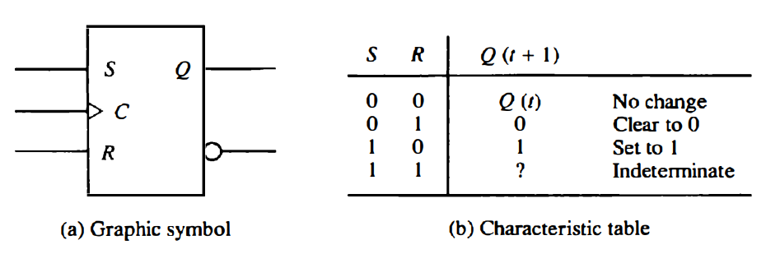
Flip Flops
Most digital systems encountered in practice also include storage elements, which require that the system be described in terms of sequential circuits.

Slide 27
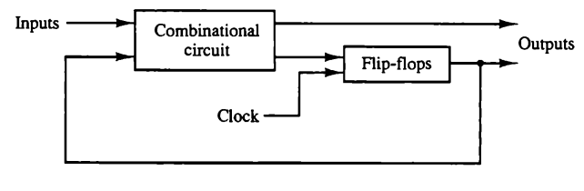
Sequential Circuits
A sequential circuit is an interconnection of flip-flops and gates.
The gates by themselves constitute a combinational circuit, but when included with the flip-flops, the overall circuit is classified as a sequential circuit.

Slide 28
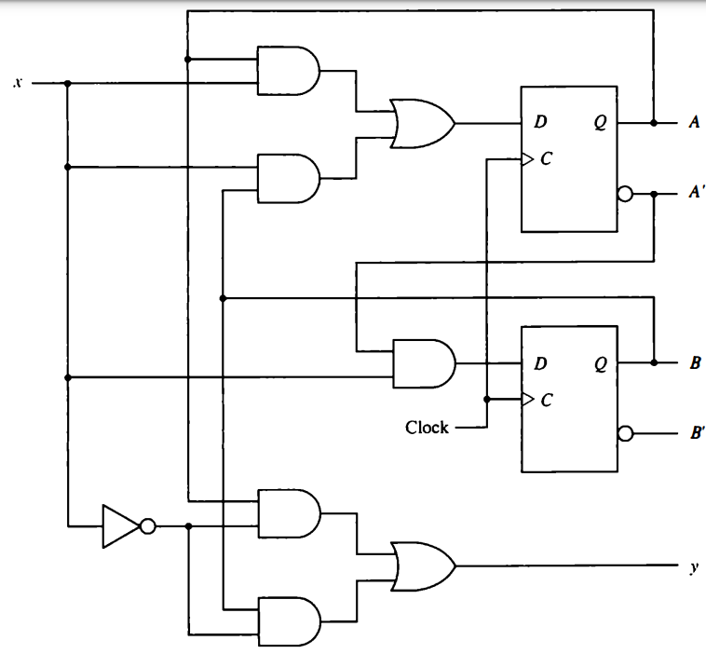
Sequential Circuit: Example
Flip Flop Input Equations
Output equation

Slide 29



Sequential Circuit: Example
Flip Flop Input Equations
Output equation

Slide 30
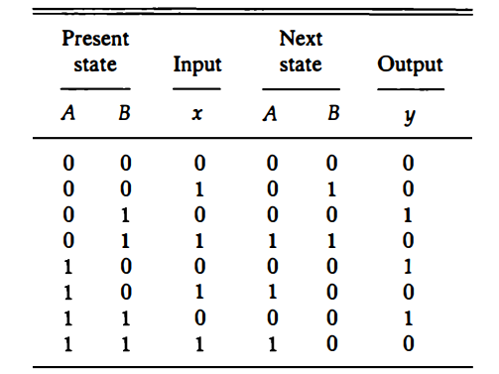
Sequential Circuit: Example
State Table

Slide 31
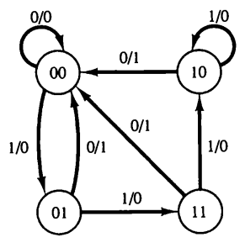
Sequential Circuit: Example
State Table

Slide 32
Digital Components
Digital circuits are constructed with integrated circuits.
An integrated circuit (abbreviated IC) is a small silicon semiconductor crystal called a chip, containing the electronic components for the digital gates.

Slide 33
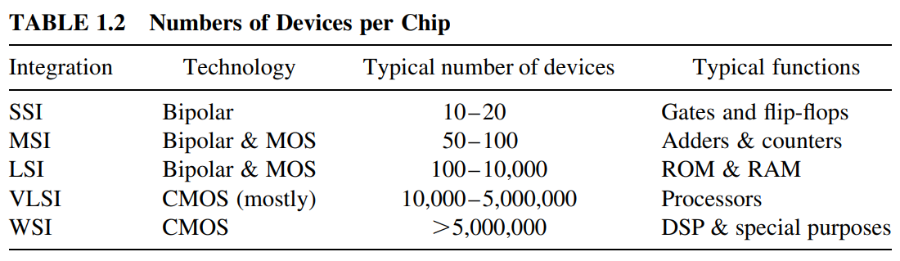
Technological Development
The scale of integration has grown from small-scale (SSI) to medium-scale (MSI) to large-scale (LSI) to very large-scale integration (VLSI), and currently to waferscale integration (WSI).

Slide 34
Digital Components: Decoders
Discrete quantities of information are represented in digital computers with binary codes.
A binary code of n bits is capable of representing up to 2^{n} distinct elements of the coded information.
A decoder is a combinational circuit that converts binary information from the n coded inputs to a maximum of 2^{n} unique outputs.
If the n-bit coded information has unused bit combinations, the decoder may have less than 2^{n} outputs.

Slide 35
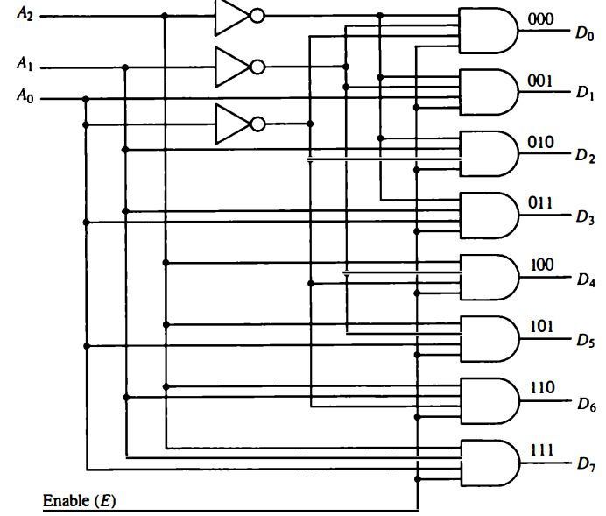
Digital Components: Decoders
3-to-8-line Decoder

Slide 36
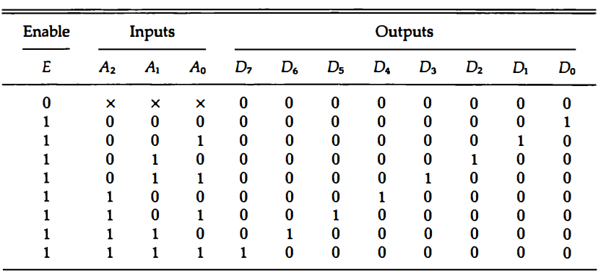
Digital Components: Decoders
3-to-8-line Decoder

Slide 37
Digital Components: Multiplexers
A multiplexer is a combinational circuit that receives binary information from one of 2^{n} input data lines and directs it to a single output line.
The selection of a particular input data line for the output is determined by a set of selection inputs.
A 2^{n} -to-1 multiplexer has 2^{n} input data lines and n input selection lines whose bit combinations determine which input data are selected for the output

Slide 38
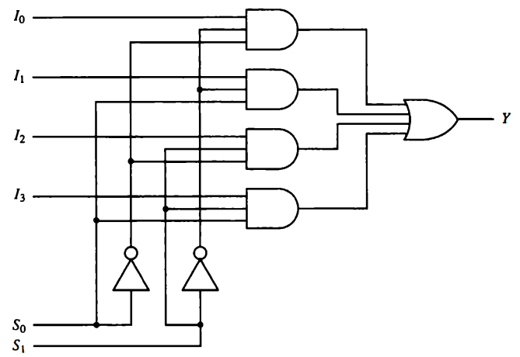
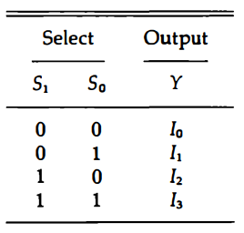
Digital Components: Multiplexers
4-to-1-line multiplexer

Slide 39
Digital Components: Registers
A register is a group of flip-flops with each flip-flop capable of storing one bit of information.
An n-bit register has a group of n flip-flops and is capable of storing any binary information of n bits.
In addition to the flip-flops, a register may have combinational gates that perform certain data-processing tasks.

Slide 40
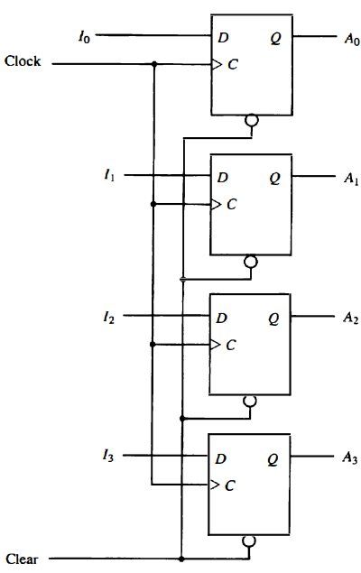
Digital Components: Registers
Register with Parallel Load

Slide 41
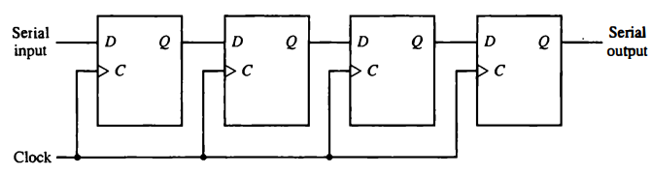
Digital Components: Registers
4-bit Shift Register

Slide 42
Digital Components: Binary Counters
A register that goes through a predetermined sequence of states upon the application of input pulses is called a counter.
Counters are found in almost all equipment containing digital logic.
They are used for counting the number of occurrences of an event and are useful for generating timing signals to control the sequence of operations in digital computers

Slide 43
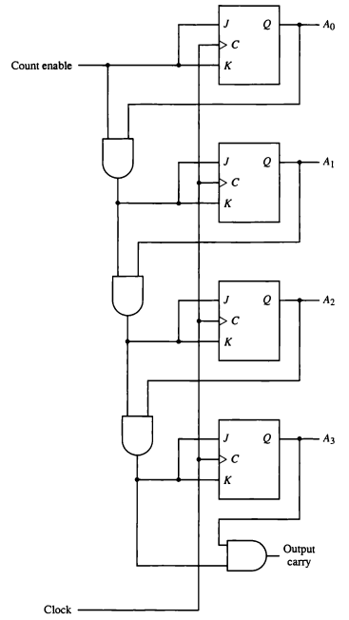
Digital Components: Binary Counters
4-bit synchronous binary count

Slide 44
Digital Components: Memory Unit
A memory unit is a collection of storage cells together with associated circuits needed to transfer information in and out of storage.
The memory stores binary information in groups of bits called words.
A word in memory is an entity of bits that move in and out of storage as a unit.

Slide 45
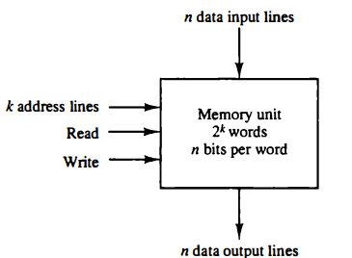
Digital Components: Memory Unit
Block diagram of random-access memory (RAM).

Slide 46
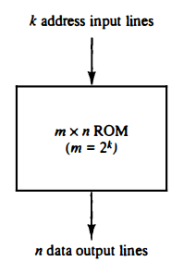
Digital Components: Memory Unit
Block diagram of read only memory (ROM).

Slide 47
End of Lecture-1

